Slide 1
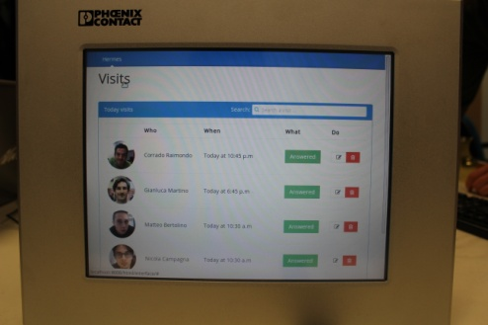

The Smart Intercom
Xplore New Automation Award 2015
Members:
Matteo Bertolino
Nicola Campagna
Corrado Raimondo
Gianluca Martino
Giuseppe F. Gullo

Slide 2
The Project
The Smart Intercom
A new and innovative system:
VoIp communication between the smartphone and the visitor;
Facial recognition algorithm;
Remote control of the sytem.

Slide 3
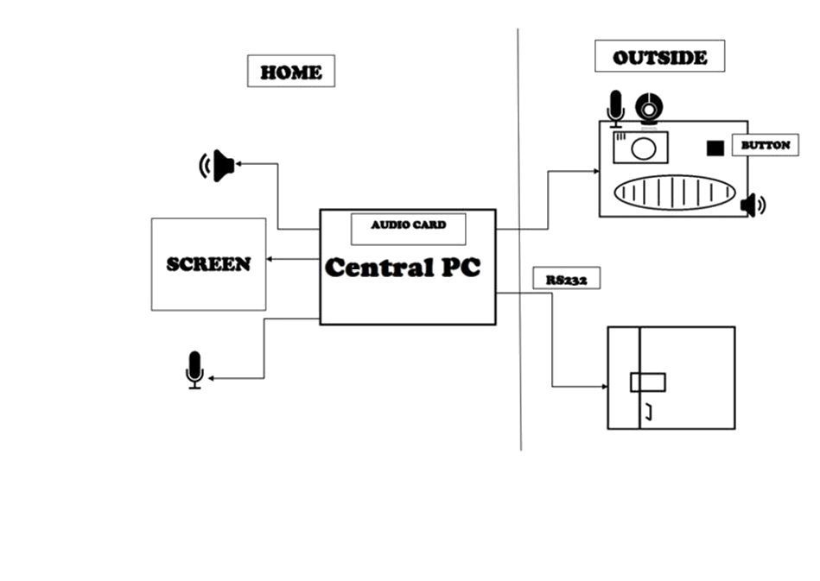
The Intercom hardware
Scheme:

Slide 4
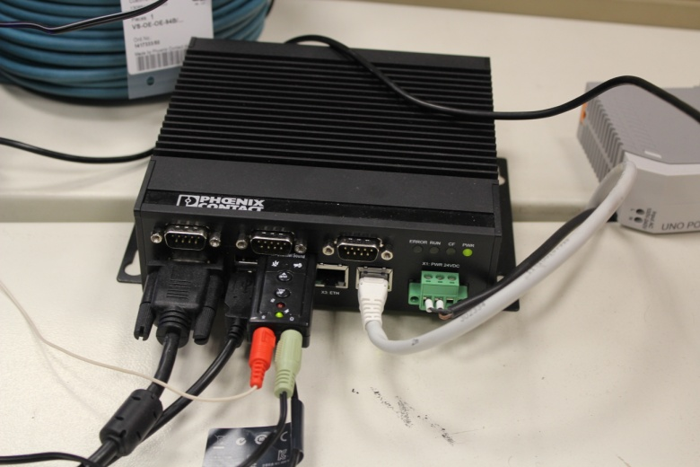
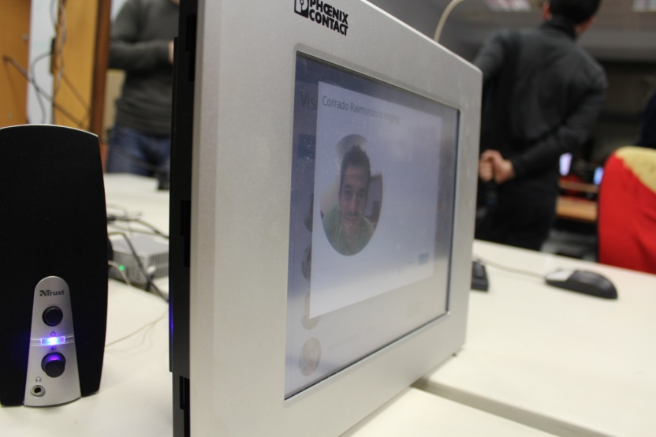
The Intercom hardware
In-Home:
central PC;
external audio card.
Touch screen;
speaker;
microphone.
Ci vuole una foto nuova

Slide 5
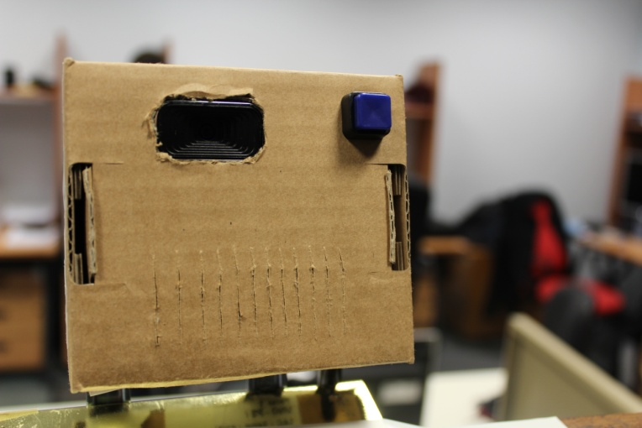
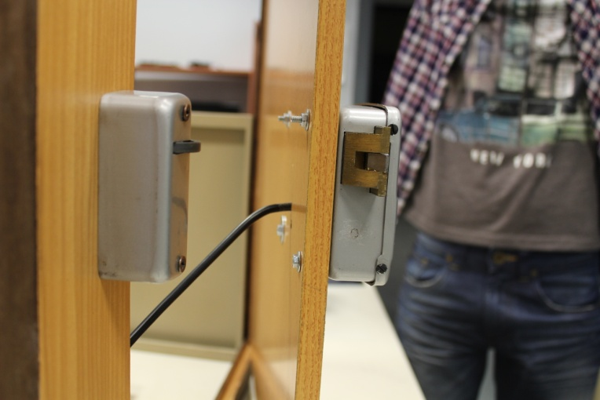
The Intercom hardware
Outside:
Ci vuole una foto nuova
Webcam with mic.
Electric lock
Speaker
Button

Slide 6
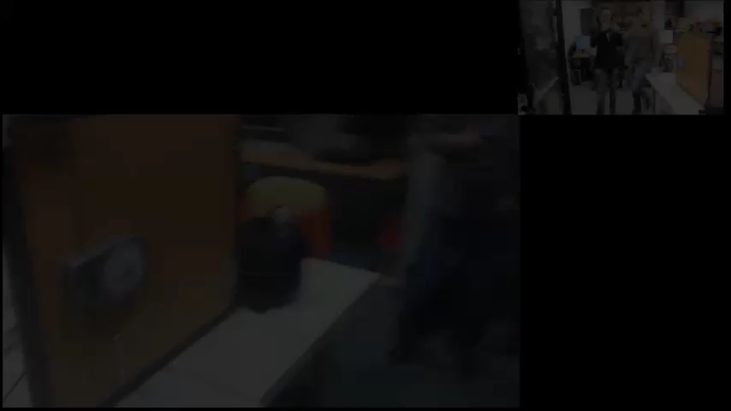
VoIp call
Communication central unit/smartphone:
The system always “calls” the smartphone application:

Slide 7
Facial recognition algorithm
The most innovative characteristic:
A database stores images and names;
The webcam takes the snapshot;
A comparison is made between the picture just taken and the pictures stored.

Slide 8
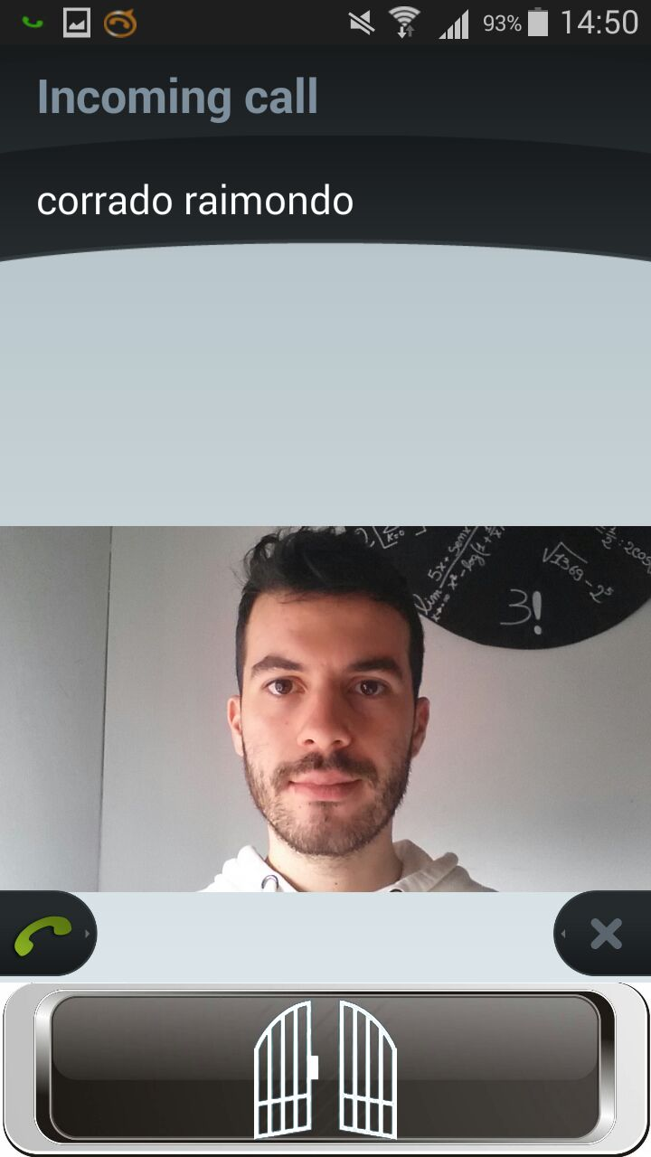
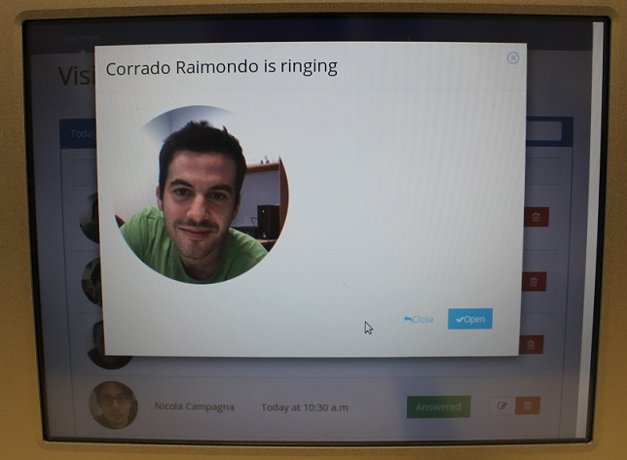
Facial recognition algorithm
Matching case:
Smartphone app
In-Home

Slide 9
Facial recognition algorithm
No-matching case:
Foto con unknown visitor sia dell’app che dell’interfaccia

Slide 10
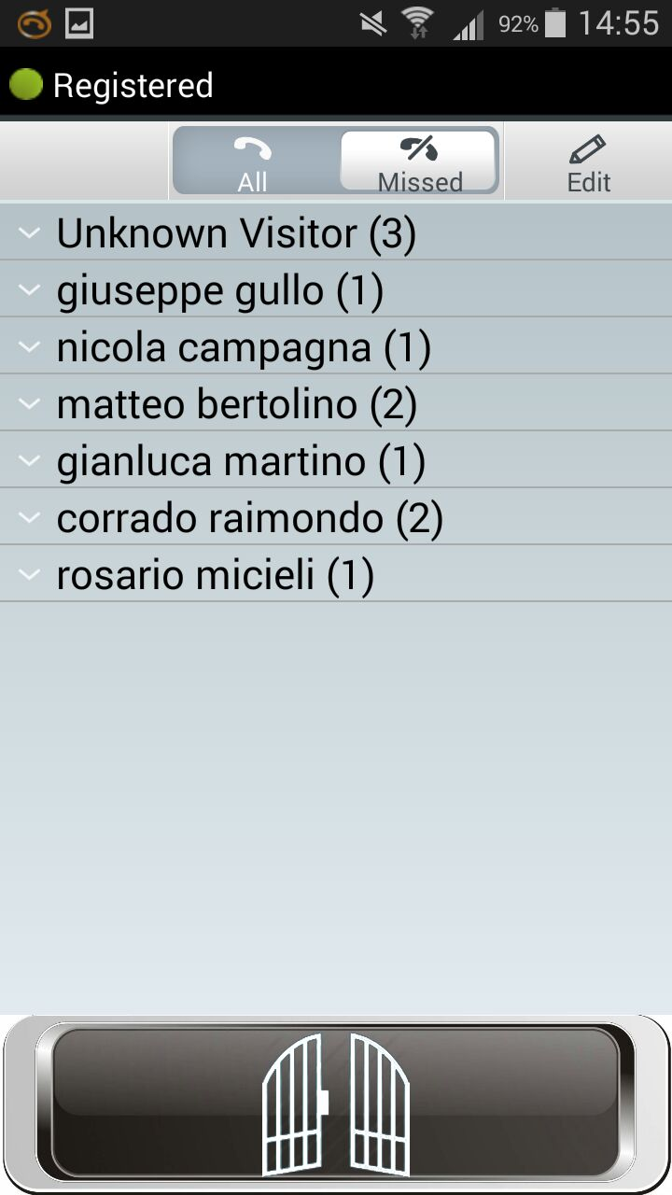
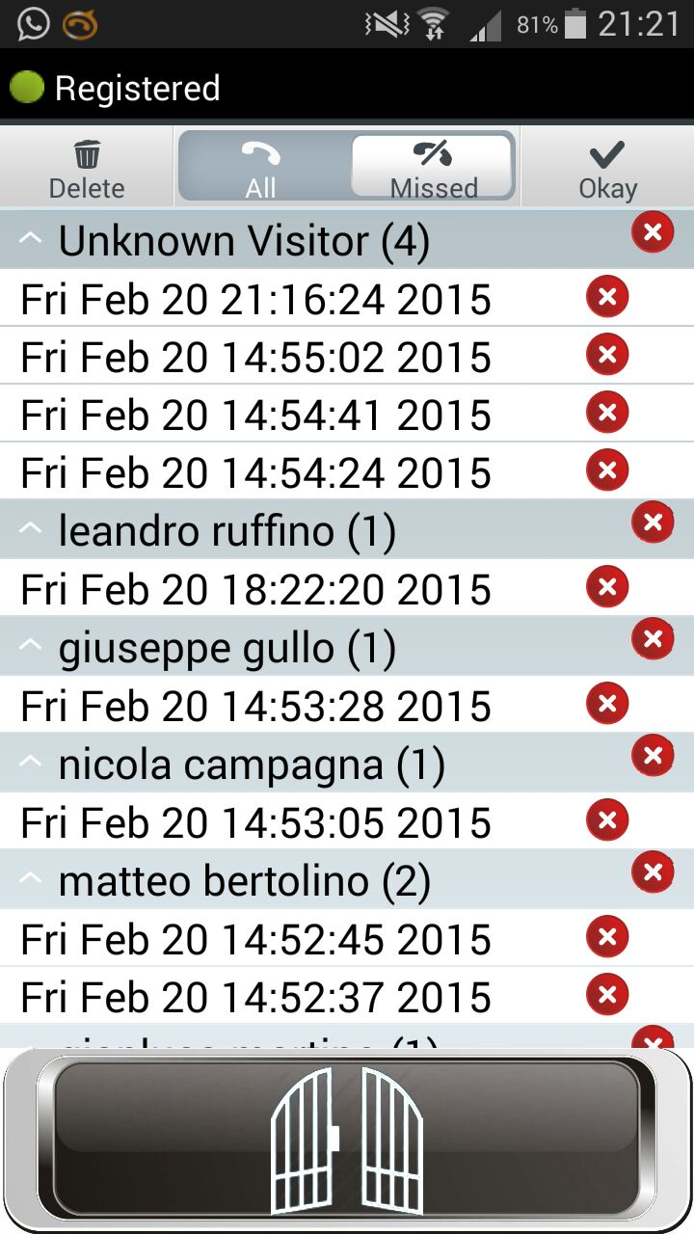
Remote control of the sytem
The smartphone application works as a controller of the whole system:
You can see the history of the last calls

Slide 11
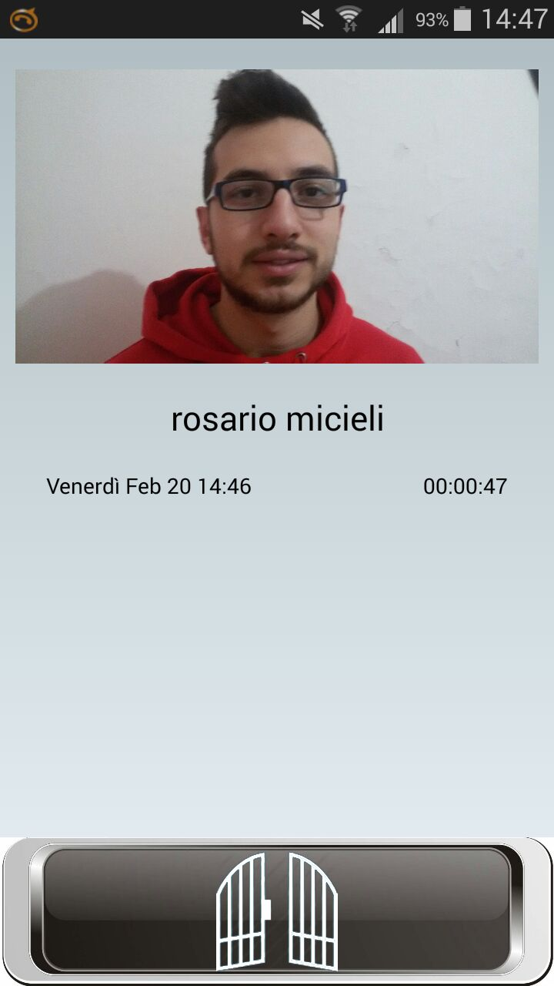
Remote control of the sytem
The smartphone application works as a controller of the whole system:
You can see the details of the calls
Metterne un’altra

Slide 12
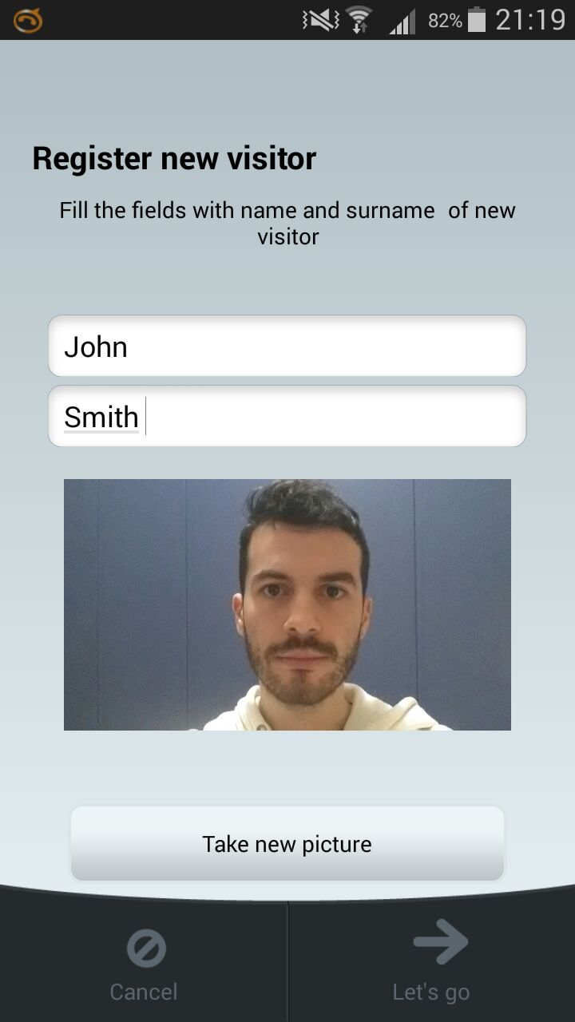
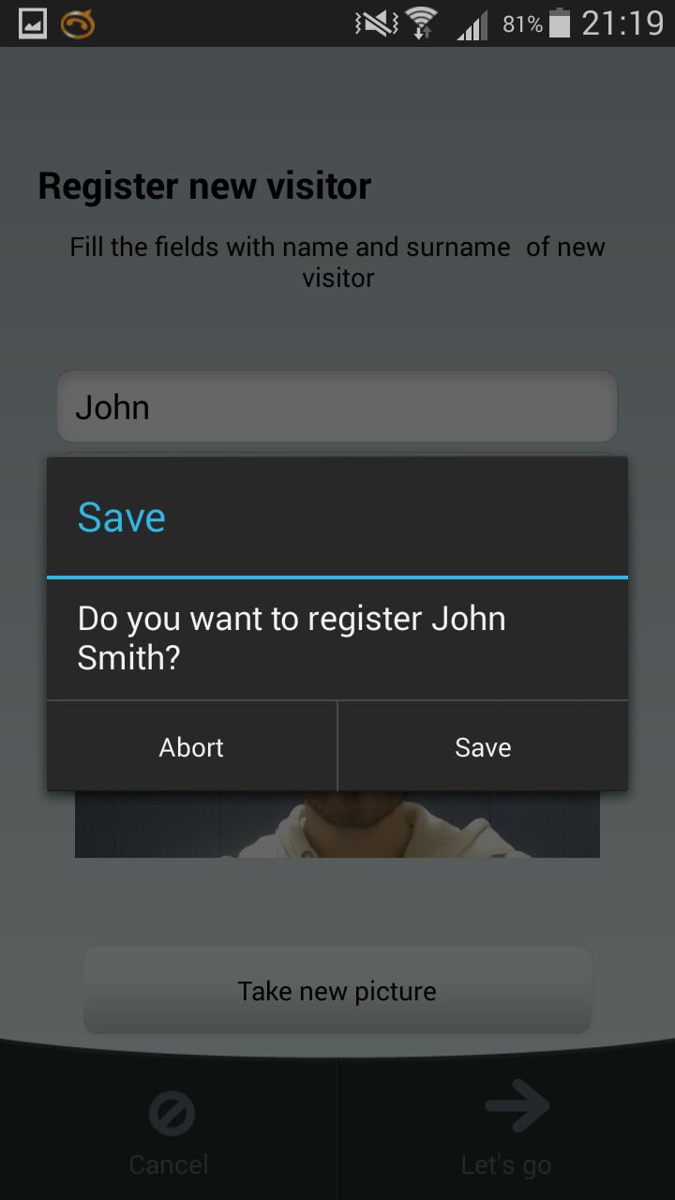
Remote control of the sytem
The smartphone application works as a controller of the whole system:
You can insert a new visitor in the database

Slide 13
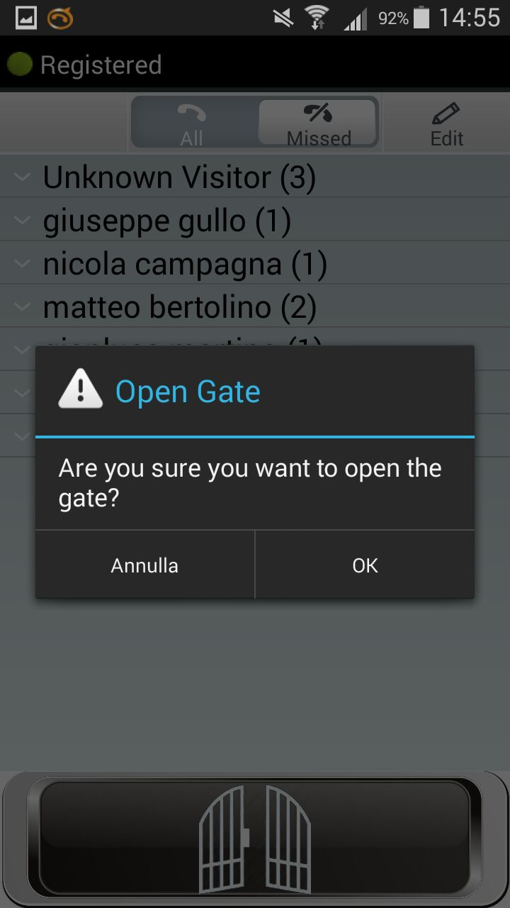
Remote control of the sytem
The smartphone application works as a controller of the whole system:
You can open the gate directly from the smartphone

Slide 14
User-friendly interface
Simple and intuitive:
Written using AngularJS API;
Very scalable;
Adding other implementations is simple;
Potentially infinite improvement;
Easy to understand and to interact with it.

Slide 15
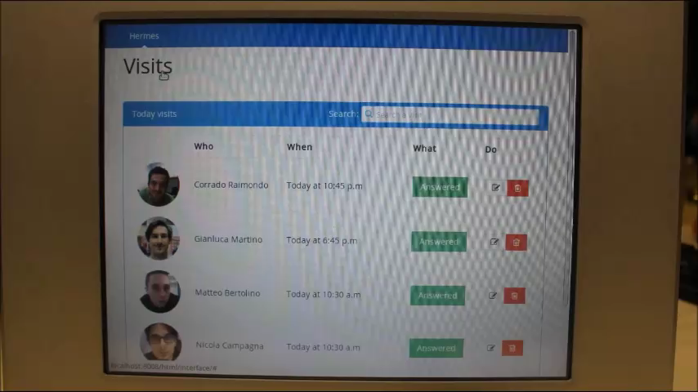
User-friendly interface

Slide 16

Utilities
Why should we use the Smart Intercom?
It lets interact with the visitor even if you’re not at home;
It implements a sort of security beacuse:
It lets know in advance who is ringing with the name (if it’s present in the database) and with the picture of the visitor;
You can ignore the visitor if he/she is a pest person;
You can open the door if you’re absent-minded and you forgot to take your keys (only if you remembered to take the smartphone, of course!).

Slide 17
Future implementations
New ideas for the future:
Implementing security;
Establishing a video call (not only a voice call);
Expanding the intercom to a fully domotic controller.

Slide 18

The Smart Intercom
Thank you!

